Slide 1
Waste, Fraud, and Abuse

Slide 2
What is Waste, Fraud, & Abuse?
Waste
Waste is the act of using or expending resources carelessly, extravagantly, or to no purpose. Importantly, waste can include activities that do not include abuse and does not necessarily involve a violation of law. Rather, waste relates primarily to mismanagement, inappropriate actions, and inadequate oversight.
Fraud
Fraud is the deliberate misuse or misapplication of an employing organization’s resources or assets.
Abuse
Abuse is behavior that is deficient or improper when compared with behavior that a prudent person would consider reasonable and necessary business practice given the facts and circumstances.

Slide 3
Question 1
In the United States, which type of fraud occurs most often?
Corruption
Asset misappropriation
Financial statement fraud

Slide 4
Question 1
In the United States, which type of fraud occurs most often?
Corruption
Asset misappropriation
Financial statement fraud

Slide 5
Examples of Fraud
Richmond DSS Scam – June 2021
Case worker accessed personal information of woman killed in a car crash
Diverted more than $13k in benefits
Facing 20 years in prison

Slide 6
Examples of Fraud (Continued):
Virtual Education Fraud – April 2021
3 defendants plead guilty to defrauding the Alabama State Department of Education
Falsely inflated # of students enrolled in public virtual schools
Skimmed state money through direct cash payments and payments to 3rd party contractors
In excess of $500k received from the scheme
Scheme started in 2016

Slide 7
Question 2
Where does fraud occur most often?
Private companies
Public companies
Local governments/governmental agencies
Nonprofit companies

Slide 8
Question 2
Where does fraud occur most often?
Private companies
Public companies
Local governments/governmental agencies
Nonprofit companies

Slide 9
Where Fraud Happens

Slide 10
Question 3
In the United States, what is the most common fraud scheme?
Payroll fraud
Asset misappropriation/Skimming
Check fraud
Billing schemes

Slide 11
Question 3
In the United States, what is the most common fraud scheme?
Payroll fraud
Asset misappropriation/Skimming
Check fraud
Billing schemes

Slide 12
How Fraud is Committed
Association of Fraud Examiners Fraud Risk Taxonomy provides 3 ways:

Slide 13
How Fraud is Committed (cont.)

Slide 14
Common Fraud in Government

Slide 15
Question 4
What are the three elements of the Fraud Triangle?
Intention, Significance, and Materiality
Perception, Prevention, and Protection
Motive, Opportunity, and Rationalization

Slide 16
Question 4
What are the three elements of the Fraud Triangle?
Intention, Significance, and Materiality
Perception, Prevention, and Protection
Motive, Opportunity, and Rationalization

Slide 17
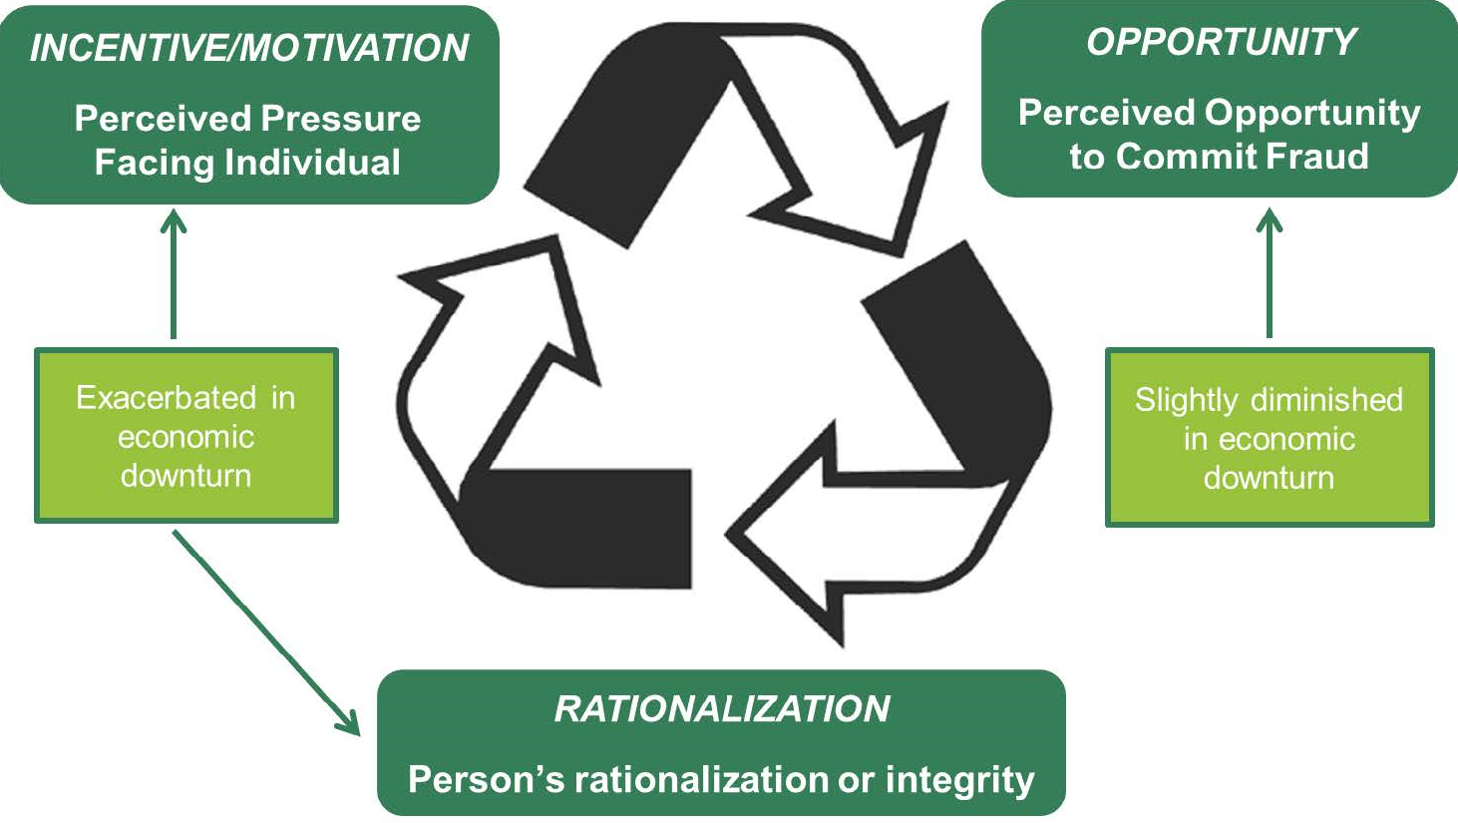
Why is Fraud Committed?

Slide 18
Question 5
On average, how long does fraud persist until the victim organization catches it?
3 months
6 months
12 months
24 months

Slide 19
Question 5
On average, how long does fraud persist until the victim organization catches it?
3 months
6 months
12 months
24 months

Slide 20
How is Fraud Concealed?

Slide 21
Question 6
How do victim organizations most frequently discover fraud?
External audits
Tips or confessions
Accidental discovery
Analytical techniques

Slide 22
Question 6
How do victim organization most frequently discover fraud?
External audits
Tips or confessions
Accidental discovery
Analytical techniques

Slide 23
How Fraud is Detected

Slide 24
Hotline and Reporting Mechanisms

Slide 25
Behavioral Red Flags

Slide 26
Question 7
In general, the best way to prevent fraud is?
Implement harsh penalties for perpetrators
Outsource all possible functions
Conduct covert audits
Increase the perception of detection

Slide 27
Question 7
In general, the best way to prevent fraud is?
Implement harsh penalties for perpetrators
Outsource all possible functions
Conduct covert audits
Increase the perception of detection

Slide 28
Question 8
Which department commits the most fraud?
Executive/Upper Management
Accounting
Operations
Sales

Slide 29
Question 8
Which department commits the most fraud?
Executive/Upper Management
Accounting
Operations
Sales

Slide 30
Question 9
What is the most common reason to commit fraud?
Poor internal controls
Greed
Personal financial problems
Dissatisfaction with employer

Slide 31
Question 9
What is the most common reason to commit fraud?
Poor internal controls
Greed
Personal financial problems
Dissatisfaction with employer

Slide 32
5 Key Principles to Manage Fraud
“Trust is not a control and hope is not a strategy”
Governance
Fraud risk assessment
Prevention controls
Detection controls
Report, Investigate, Correct

Slide 33
Recipe Against Fraud
1 cup of positive pay
1 tablespoon of payee validation (this will add significant amount of flavor without added calories)
2 cups of ACH Fraud Filter – you can use either Review or Stop
1 pinch of Account Validation, to taste
5 ounces of daily reconciliation
1 quart of dual custody
A smidge of multi-factor authentication
One thorough internal policy against cyber fraud
A gallon of common sense
Mix all ingredients thoroughly under constant vigilance. Make sure as others approach your “kitchen” with changes to the recipe, these are validated for accuracy as they can dramatically alter the flavor of the dish. We recommend cooking with the assistance of your banking team to ensure the meal is enjoyed by all without added risk.

Slide 34
Questions?

